Slide 1
Realtime global illumination and reflections in Dust 514
On the PS3, in 1080p.
Hugh Malan / CCP Newcastle

Slide 2
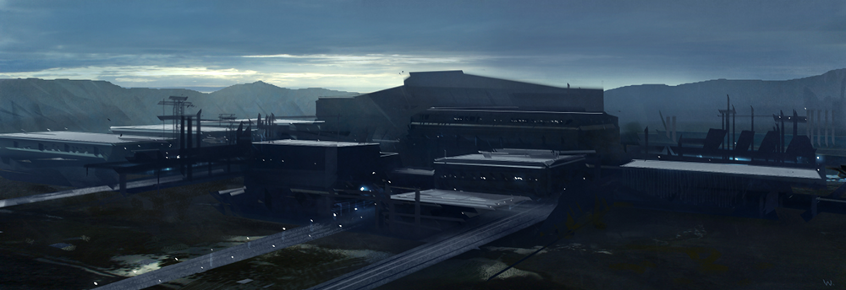
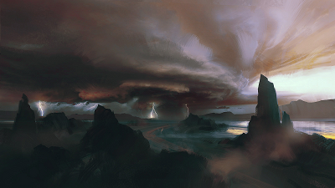
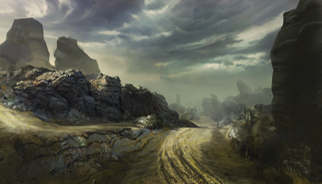
Motivation
Notes:
Dust 514 needed to have large maps, with as much environment variety as possible. These are some concept images showing the range of environments and lighting we’d like. So we want lots of different planet surfaces, and lots of different lighting moods, in any combination.

Slide 3
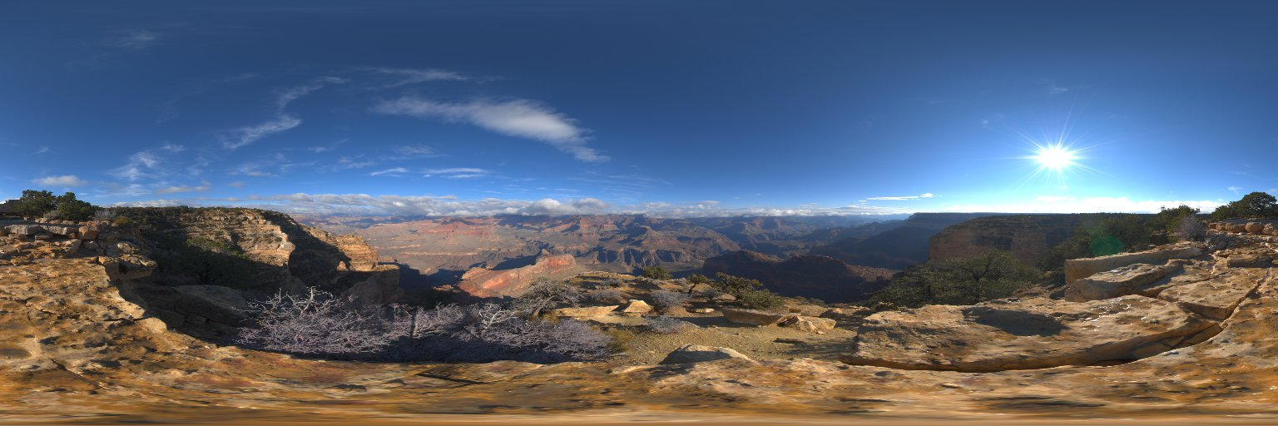

Motivation
Notes:
We'd also like to use a more physically based lighting model; there's a lot of literature out there on the advantages of this. What it means it that we'd like a per-pixel indirect and reflection term that can be evaluated at any point in space, for any surface normal or reflection direction. If it could provide blurry reflection too, that would be great.
The upper image shows the environment at a given point in space – it’d be used for reflections. The lower image is a Lambertian convolution of that environment, which would be used for the indirect term.
If physically based rendering isn’t a persuasive argument: well, there's a lot of metal, and metals need reflections to look good, so we'd like a fast, general way to do reflections, but we we’re willing to sacrifice some quality.

Slide 4
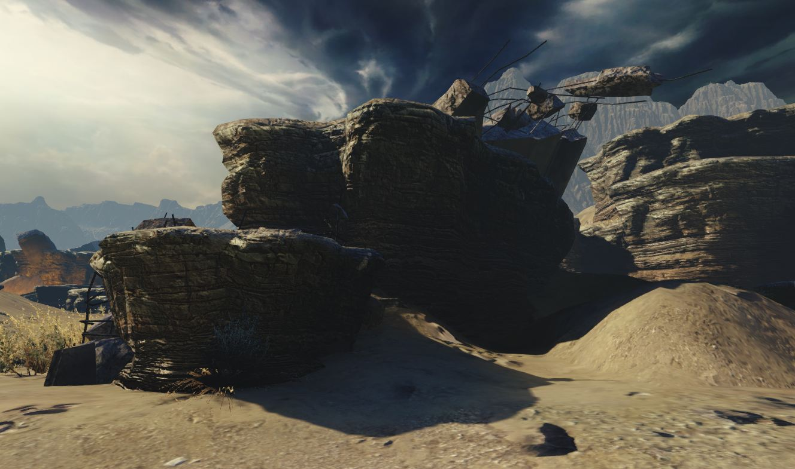
Notes:
Before diving in, here’s some results of the tech that got developed.
This screenshot shows off the indirect term. The lighting in this scene is a single directional sun light with shadowmapping, plus the indirect and reflection terms provided by the tech I’m going to talk about. Without this tech everything in shadow would be black.
Notice how the shadowed side of the rocks is brighter or darker depending how much bounce light is present.
There are no lightmaps here, everything is generated in realtime. The sun direction can be changed in realtime, the rocks and other objects can be moved and duplicated and deleted, and so on.

Slide 5
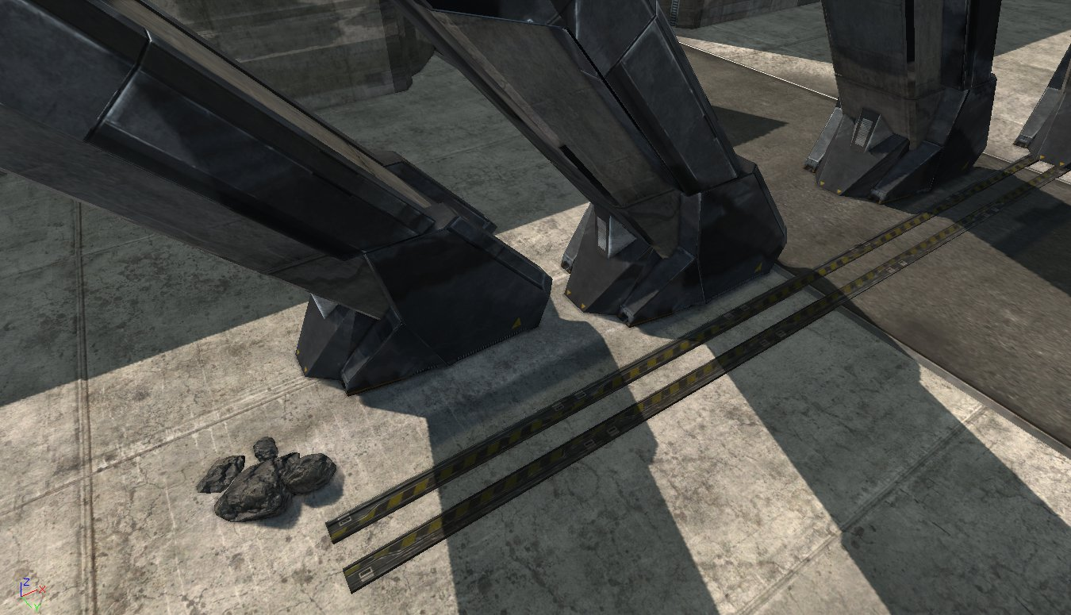
Notes:
This screenshot shows the reflections in action. In the reflections you see the shadows, changes in tone of the ground, and the dark shape where the two rails go. Again, the objects can be moved around in realtime, duplicated, deleted, the light direction changed, and so on.

Slide 6
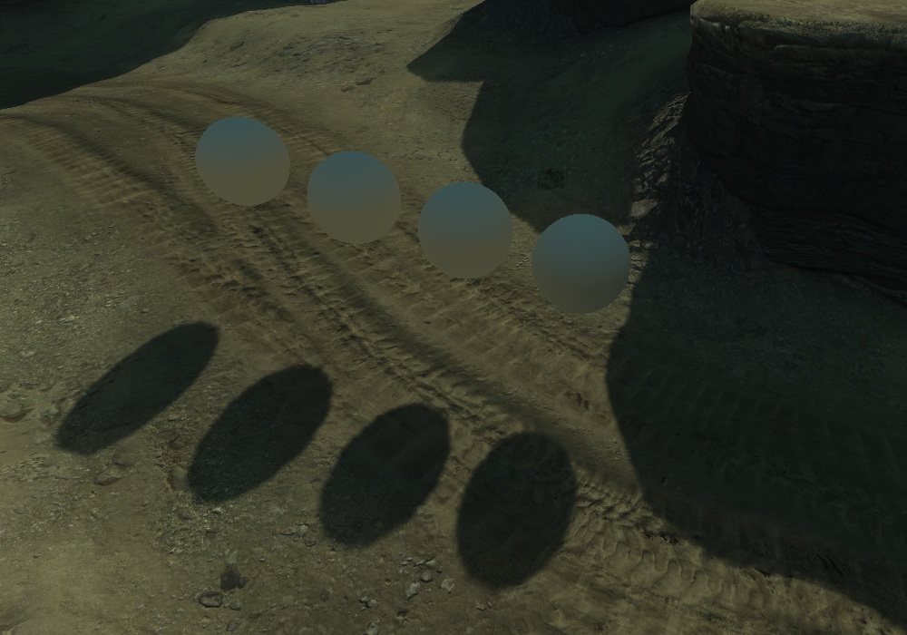
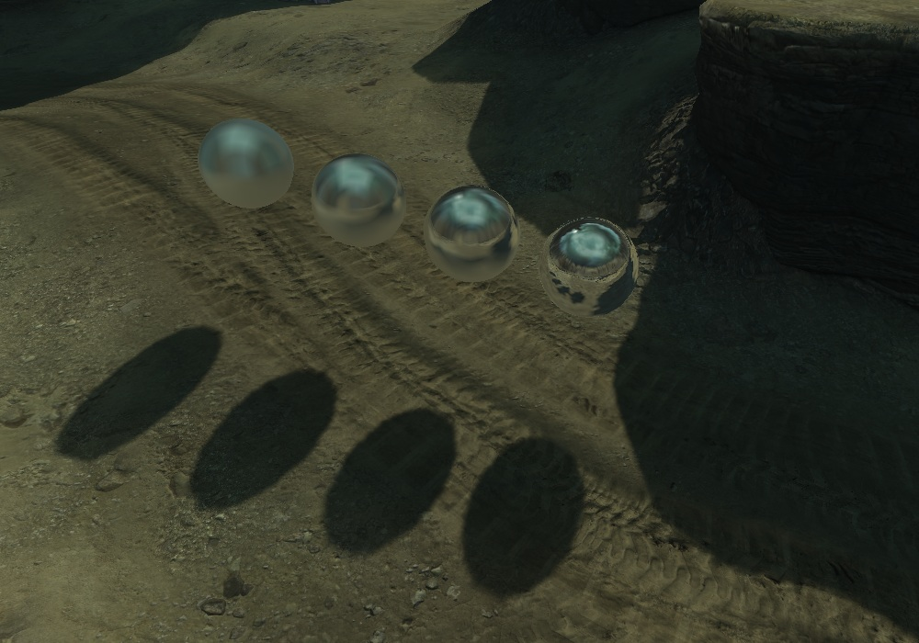
Results
Notes:
Here’s what the actual indirect and reflection contributions look like. The spheres on the left show the indirect term; notice how it gets darker as the spheres approach the shadowed area.
The righthand image shows varying blurry reflections. Notice that the spheres don’t reflect each other, they’re only picking up the environment.
This tech is all running on the PS3. The indirect and reflection terms are cheap enough to run in the pixelshader. On the PS3 at 1280x720 the costs of evaluating indirect for every pixel are about 1.5ms, and about 2.0ms to evaluate the reflection for every pixel. In addition we have a 2ms budget for the per-frame lightcache update. The indirect and reflection functions are continuous with respect to query position and direction, and should never introduce hard edges. There’s no per-object state; these spheres could be drawn in a single batch. So this tech can be applied to objects regardless of their shape and size.
Getting this tech to fit onto a console needed a lot of pretty brutal approximations and shortcuts, but as you can see we get something pretty reasonable for the cost we’re paying.

Slide 7
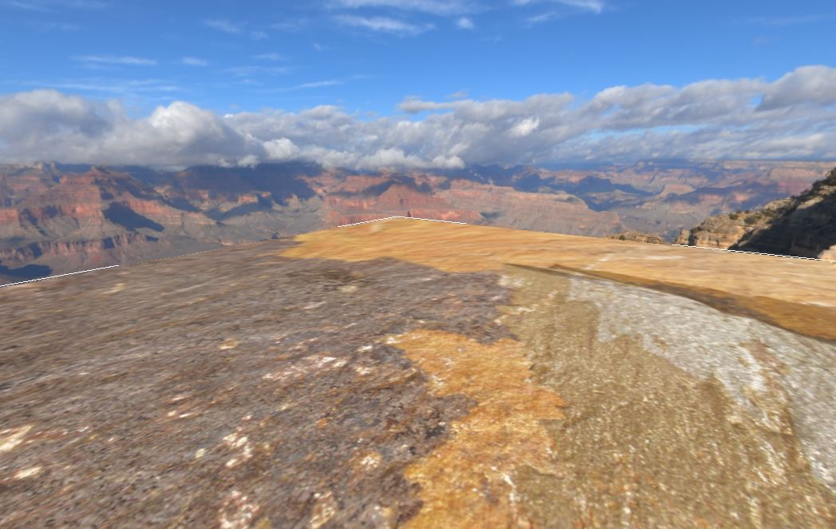
The basic idea
Notes:
So what we’d like is a conetrace function available in the pixelshader. That is, a function that takes a position, key direction and some conception of cone angle; it traces a large number of rays that originate from the query point but deviate from the key direction by less than the cone angle, and averages the results. A near-zero angle would provide mirrorlike reflections; a larger angle provides blurry reflections, and larger angles will be used to approximate the indirect term. This concept is pretty similar to the one described by Cyril Crassin in “Octree-based sparse voxelization for Real-time global illumination”.
We’d like something that’s affordable for the PS3, that’s robust, and is applicable to an environment the size of a game level. We have to be willing to sacrifice quite a lot of accuracy and features to achieve this: implementing anything resembling the normal sort of raytrace that you’d run on a CPU for an offline raytracer is not even close to affordable for the PS3 pixel shader for a game.
So, we went looking for conetrace possibilities that are simple and cheap enough for the PS3 pixel shader. This slide shows something we can afford: a single textured flat plane, surrounded by a skycube.
We can implement a standard raytrace: do some maths to figure out whether our ray hit the ground or the sky, figure out where we hit it, and sample the ground texture or the sky cubemap.
To simulate the cone angle, the averaging of all points in the covered area is approximated by sampling from an appropriate mipmap. If it's a small area, use a high-res mipmap, and if it's a large area, use a low-res mipmap. We’ll also have to have a gradual blend between the groundplane and sky color near the horizon, so there’s a smooth transition between them rather than an abrupt change. The transition region will also have to get bigger for larger cone angles.
The operation of doing a raytrace and using mip bias to approximate the different intersection area is a very rough approximation to the ideal conetrace I described, but it's extremely well-suited to the GPU's strengths since it all boils down to sampling mipmapped 2D textures.

Slide 8
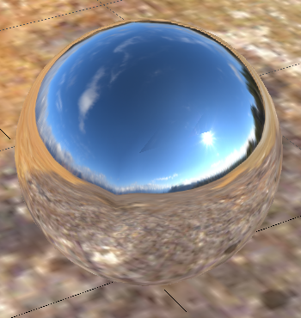
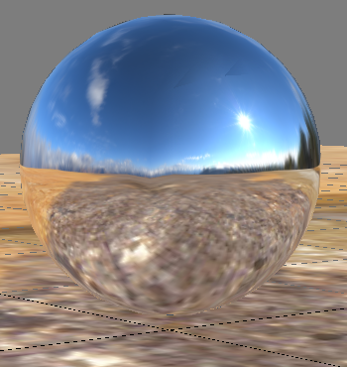
Reflection term
Notes:
Here’s a sphere showing the reflection term evaluated in realtime. This isn’t anything very exciting - intersecting a ray with a flat groundplane in the pixel shader is pretty straightforward stuff. The point is that we have a function to calculate the reflection term that physically based models require, and that function can be evaluated for any ray.

Slide 9
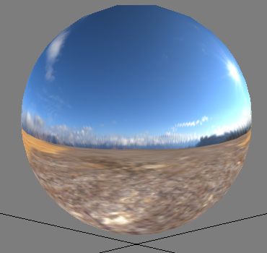
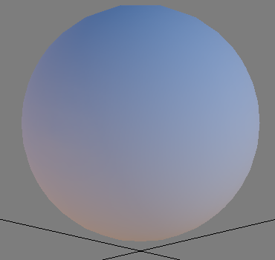
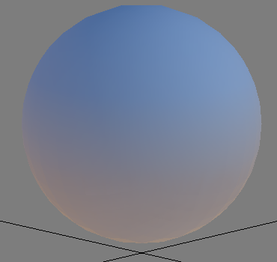
Indirect term
Environment
Ideal
Realtime
Notes:
From left to right the three images show the original environment, the ideal convolved environment, and the realtime approximation.
The ideal indirect term was calculated offline using the Lambertian convolution described earlier. It took several seconds to compute. On the right is the cone-trace approximation, evaluated in realtime in the pixel shader. The transition is a linear blend between sky color and ground color based on the Z/up component of the surface normal; the ground color was obtained by sampling the ground texture with a substantial mipbias. It’s undoubtedly possible to set up a better approximation by spending more cycles.
Anyway, the point is that we have a way to provide an indirect term for any point in space, and for any surface normal direction. Combined with the reflection term shown on the previous slide, we have a solution for all environments that can be approximated with a single flat horizontal plane and a skycube. If we were working on FIFA, we’d be done.

Slide 10
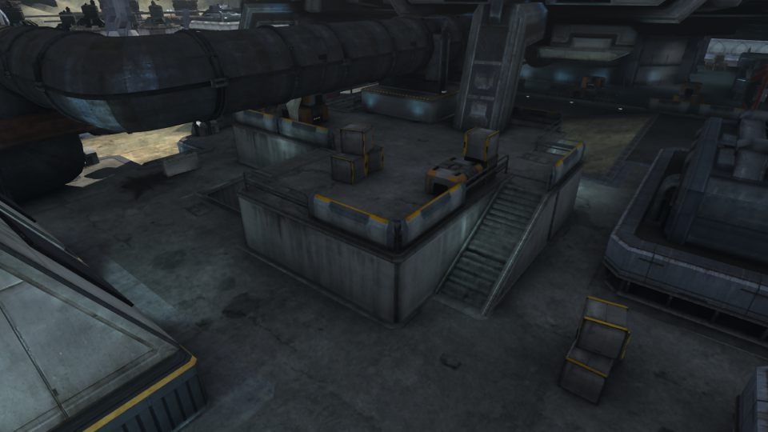
Notes:
But of course, it’s not good enough for the sorts of environments we have in Dust 514, or most other games out there today.
First of all, a completely flat ground layer is unacceptable. We need height variation, so we’ll use a heightfield instead of a single flat groundplane. This combination of texture plus heightfield is what I’ll call a layer.

Slide 11
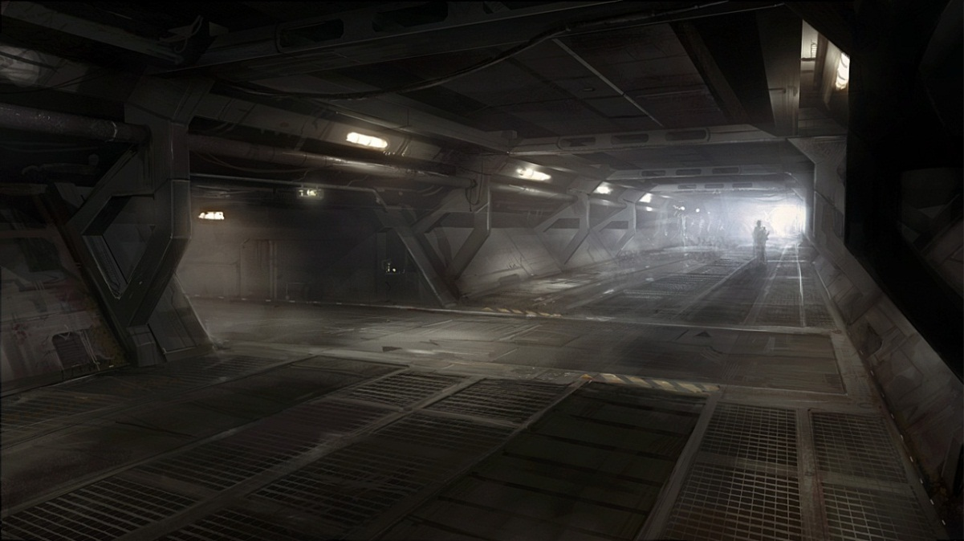
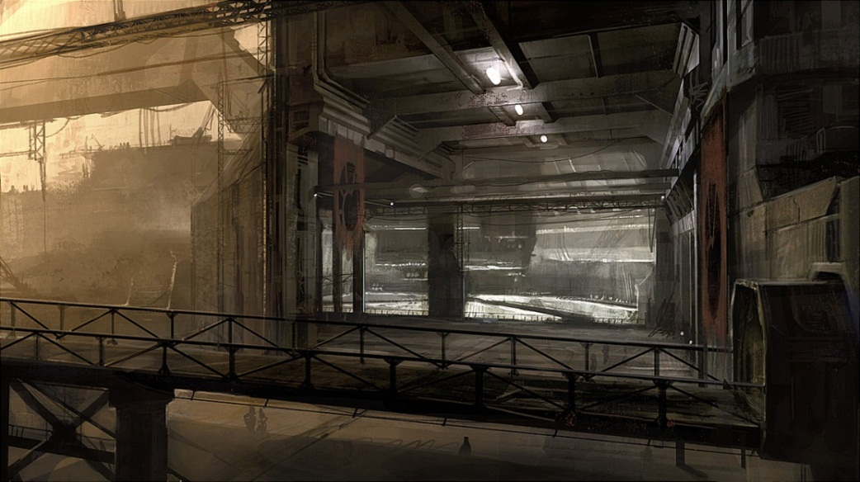
Requirements for Dust 514
Notes:
Secondly, there are ceilings, so we're going to need another layer to represent them. For the ceiling we'll need an alpha channel, to control where the sky should show through and where it shouldn't.
Also, we're going to need to support bridges. They will look very different from above and beneath so we'll need two layers. That adds up to four layers in total. Four heightfields is great because we can pack them into the RGBA channels of a single texture with no waste.
This was enough for Dust: we don't have situations where several bridges or rooms are stacked one above another, so there was no strong argument for us to add another layer. Adding another layer would have meant we go from 4 to 6 heightfields and textures, so it’d raise the cost by roughly 50%. While the play area of Dust’s maps is well suited to division into floor, bridge and ceiling sections the same can’t be said for all game environments – for example, there’s a ton of environments in Deus Ex: Human Revolution that break this requirement. There are some options here for supporting these environments which break this rule which I’ll cover later.
One pretty major drawback that needs to be mentioned is walls and other vertical surfaces. If the layer textures are generated using orthographic renders then all vertical and near-vertical surfaces will get foreshortened or completely removed. There are ways to reduce and work around this problem that I’ll cover later, but this problem is a pretty fundamental weakness of the basic approach.

Slide 12
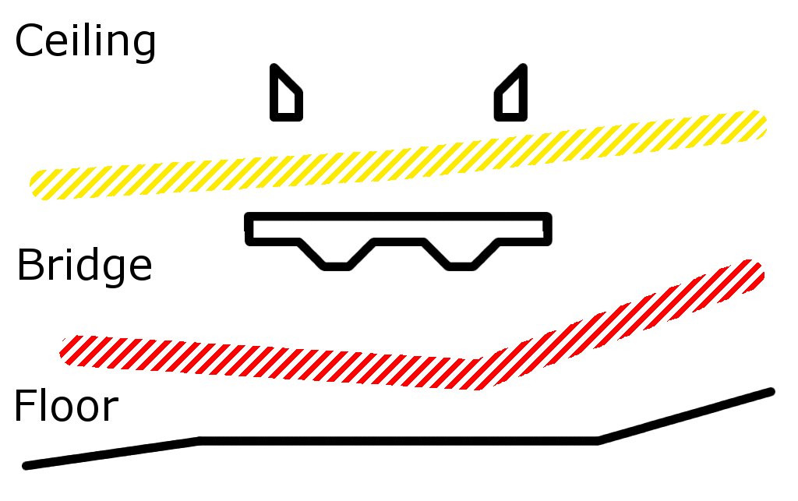
Layers
Notes:
Anyway, here’s a cross-section of the scene, showing how it’s split up. Black outlines indicate geometry, and the yellow and red indicate where the scene is divided up – these dividing surfaces are controlled by the artists.
To generate the texture and raw heightfield for one of the layers, the scene is rendered from above or below using an orthographic projection. The red and yellow dividers are encoded in a texturemap, and used to discard pixels that fall outside of the region relevant to the layer we’re rendering. The resulting texture has mipmaps generated and is ready for use.

Slide 13
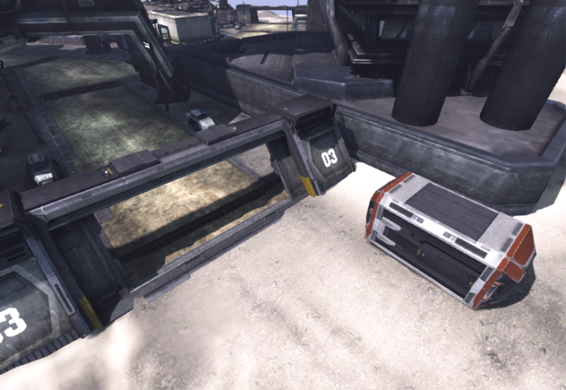
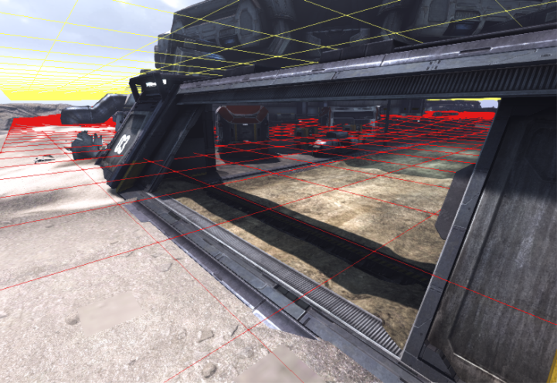
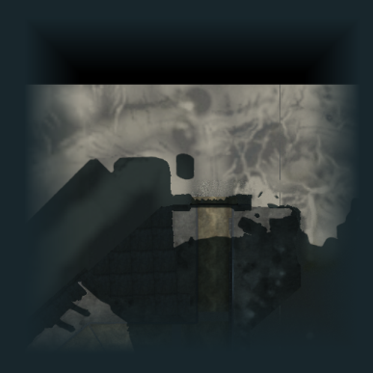
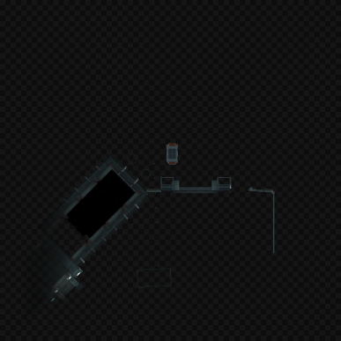
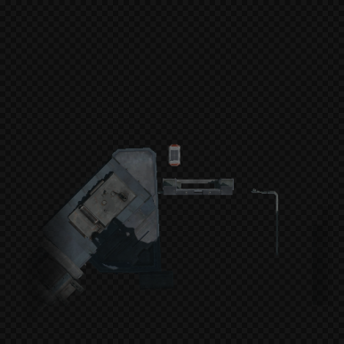
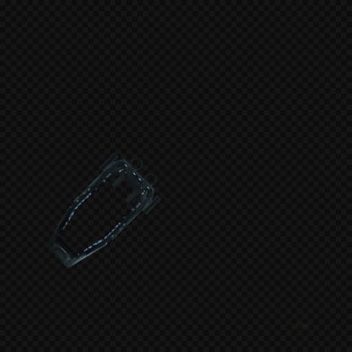

Layers
Notes:
Here’s an example location and the layer textures generated for it. From left to right, the images are the floor, the bridge from underneath, the bridge from above, the ceiling, and lastly the packed heightfields. The dark grey checker pattern indicates transparent regions. For Dust we’re using 512x512 8 bit-per-channel textures. The four color textures have a full mipchain, the packed heightfield doesn’t need it.
Just to reiterate, these five textures are continuously rebuilt at runtime, and the region they cover stays centered on the camera.
The top righthand image shows a yellow and red grid; it’s the dividing surface I described on the previous slide.
A few slides back, I innocently suggested we raytrace a heightfield in the pixel shader. Raytracing a heightfield is rather expensive if it's done with full precision. It is absolutely possible - there are many papers published on acceleration methods, but it’s basically unaffordable for what we’re trying to do here.

Slide 14
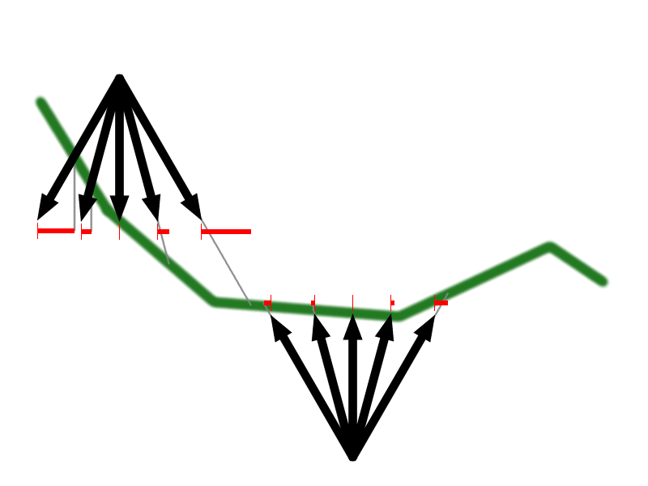
Raytracing the heightfield
Notes:
So we took the cheapest imaginable option: intersect the ray with a flat horizontal plane whose height is determined by sampling the heightfield under the ray origin.
This is a pretty ugly approximation. The slide shows rays originating from two example locations, the errors are indicated by the red bars.
This approximation will introduce errors if the heightfield isn’t flat, there will be worse errors if there’s an abrupt height transition. The approximation becomes more dangerous the further we move from the ray origin. It also means rays will skip right through vertical and near-vertical surfaces, in addition to the other problems those surfaces have.
However, it does have a couple of very nice properties that are very useful for what we’re using it for. If the heightfield is smooth it’s guaranteed not to introduce any discontinuities, which would mean sharp edges or abrupt transitions in the reflection – either of those artifacts is very noticeable and very wrong. Pushing up the mipbias is certain to produce a blurrier result and will also never introduce any sharp edges. The approximation gets pretty accurate if the ray origin is close to the heightfield, or if the ray is largely vertical, so where objects touch the floor they’ll get very accurate traces. And while the intersection point it returns is going to be a pretty poor approximation, the hit position is guaranteed to correlate with the query ray direction. This means reflections will flow over reflective objects in a plausible way as they move around. It also means the reflections are locally consistent. For example, shaped area lights will appear in the reflections with that shape.
If you have a large mirrorlike surface you’ll be able to spot the discrepancies, but more complex or less shiny surfaces make it very difficult to see the problems.
The biggest issue is near-horizontal rays. It’s an invitation for disaster to rely on the planar approximation for even a moderate distance. One thing we can do is to clamp the ray intersection point to a fixed maximum distance from the ray origin.

Slide 15
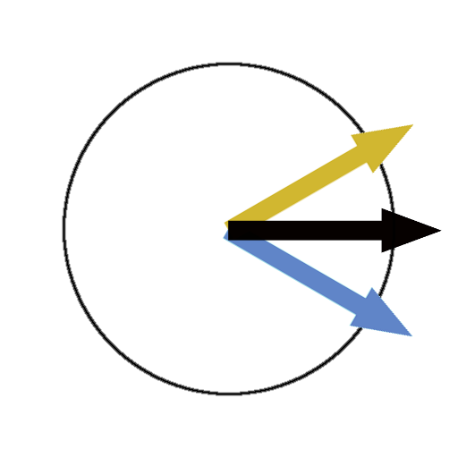
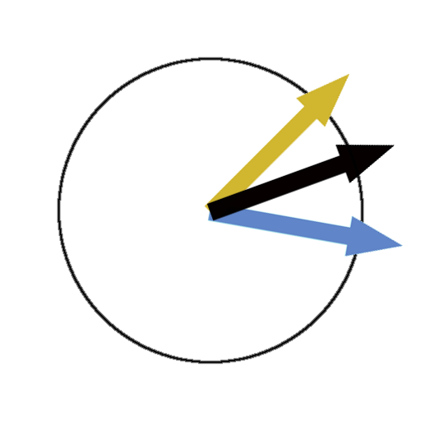
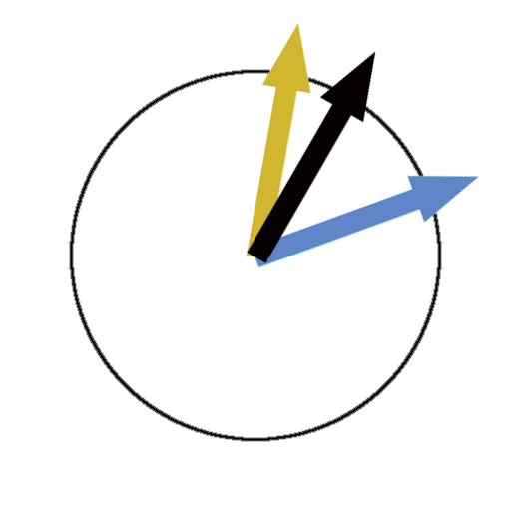
Ray bias
Notes:
Another is use separate biased rays for up and down traces, so we never show the result of a horizontal raytrace.
The original ray is shown in black on the slide. We'll derive two new rays from it, one biased up and one down. The biasing is done by adding or subtracting from the Z component and renormalizing. The "down" ray is used for raytracing against the upper side of the bridge layer and the floor. It’s shown in light blue on the slide. The "up" ray is used for raytracing against the ceiling and the underside of the bridge layer. It’s shown in yellow on the slide.
Horizontal rays will still be traced. For example, in the middle image the original ray runs slightly up and the new ray that's biased down is completely horizontal. However, if one of the biased rays is close to horizontal then the other will not be, and the crossfade between the up and down results can be arranged so the problematic rays don't contribute anything to the final blended color.
This change makes the raytrace approximation even less accurate, but it still preserves the correlation between ray direction and hit location and won’t introduce aliasing, and means the problems of near-horizontal rays don’t appear in the final result.

Slide 16
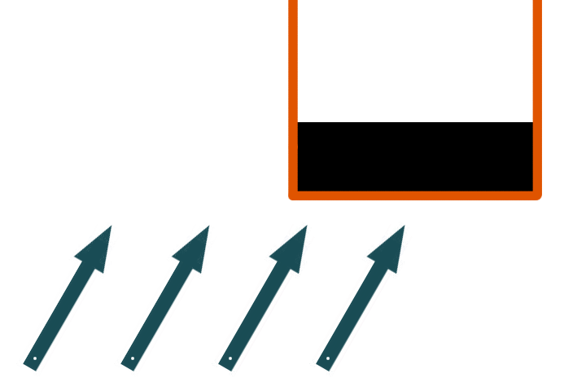
Heightfield refinement
Notes:
The one-sample raytrace step works well enough in most cases, but it completely fails in some situations. This slide shows a cross-section illustrating the problem. The black rectangle shows an object such as a bridge; the orange line is the heightfield that’s generated when the scene is rendered from below. The arrows on the bottom left indicate some sample rays, such as reflections from top of a vehicle passing underneath.
The problem is that the intersection point will change discontinuously as the ray origin travels under the roof. On the top of that vehicle, there will be a noticeable discontinuity in the reflection just under the edges of the bridge. While we can still have a plausible reflection with inaccurate intersection points, discontinuities are very noticeable and obviously wrong.

Slide 17
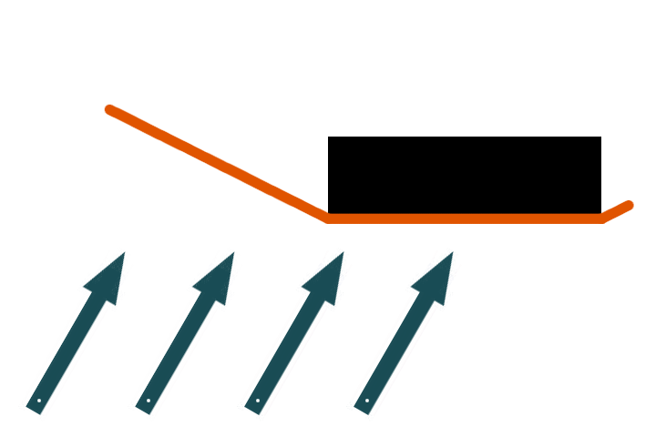
Heightfield refinement
Notes:
The solution is to apply a postprocess to the heightfields to ensure that the height never changes abruptly; this produces the cross-section shown here. It means the reflections won’t ever have discontinuities so we get much more plausible reflections as a result. It also has benefits for the one-step raytrace approximation.
The heightfield process is done incrementally; it takes several passes for the heightfield to converge to the result shown here. Here’s how it works.

Slide 18
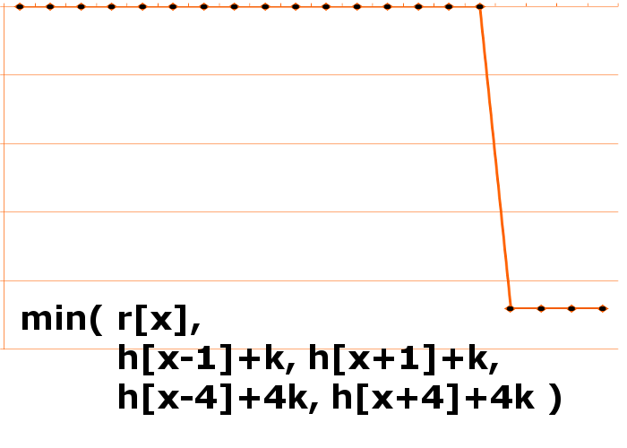
Heightfield refinement
Notes:
The refinement formula is shown at the bottom. Since we’re looking at a cross-section I’ve given the formula for a 1D domain; in practice we’re working with a heightfield but the extension to a 2D domain should be pretty obvious.
What the function does is take a maximum of a couple of different samples. It takes the height of all the samples one step away, and ensures that the new height is at least one step below them. It takes the height of samples four steps away and ensures that the new height is at least four steps below them.
The GPU has done an orthographic render of the scene to generate a heightfield – this is the array r in the function above, it’s indicated by the black dots on the graph. The rightmost samples pick up the bridge, the rest of the samples hit the sky and so are being clamped to the maximum possible value. The parameter h is the last iteration of the heightfield we’re processing. The constant k is the gradient we’re enforcing.
The orange line shows the result of the first iteration. The last heightfield h was initialized to the maximum representable value so it outputs a copy of r.

Slide 19
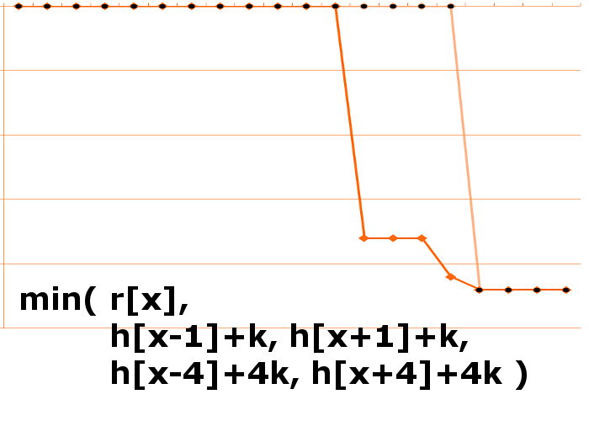
Heightfield refinement
Notes:
Here we have the results of the second iteration, shown in bright orange. The dimmer orange line shows h, the previous step. Notice how samples within four steps of the bridge have changed. The sample that’s one step away from the bridge gets a different result to the others.

Slide 20
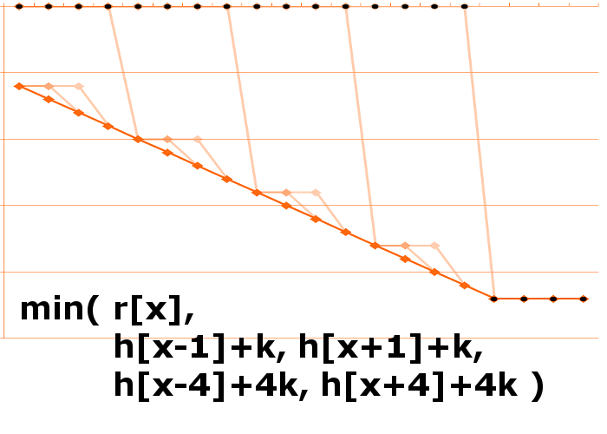
Heightfield refinement
Notes:
After another few steps the graph has converged to the result we’re after, shown in bright orange.
The crucial things controlling how fast the process converges, how quickly changes propagate across the map, and how it responds to change are the enforced gradient k, and the set of step distances.
This example just uses the step distances 1 and 4. In practice we used 1 and 4, and 1 and 16 on alternate frames so changes could quickly propagate long distances. This is just an acceptable solution, not a finely tuned and researched set of values though.
I mentioned earlier that we used four textures and four heightfields in Dust 514. These four heightfields are packed into the RGBA channels of a single texturemap, and so this incremental update function updates all four in parallel. Also, two of the four heightfields are rendered from above and two from below, so for two of the channels we want to use min() as shown here and the other two use max(). It’s still pretty straightforward to parallelize all this though, so all four heightfields are updated in each pass.

Slide 21
The entire trace procedure
Compute up/down biased ray vectors
Sample packed heightfield at ray origin
Compute intersection point for each layer
Compute mip bias for each layer
Sample the four layer textures and sky texture
Composite the results to produce an up and down color
Sky, ceiling, bridge below
Floor, bridge above
Blend up/down colors based on query ray direction
Notes:
Here’s the full process for tracing a ray. The two biased rays are generated, for each ray the intersection point with the two relevant layers for it is found, then each of the four layer textures are sampled at the appropriate point. The sky texture is sampled too, and then the five resulting colors are composited for each of the two biased rays using the order shown. The final color is a blend between those two colors based on the query ray direction and cone angle.
It’s pretty much the same for both the indirect and reflection terms; the biggest difference is the calculation of the mipbias, calculation of the final blend between up and down colors, and support for edges cases such as how to handle rays originating from underneath the floor heightfield. The indirect term can also ignore the horizontal component of the rays altogether and cut a few other corners too, which saves some cycles.
Most of the maths for the raytracing the four layers can vectorized and be done in parallel using vec4s. Also, the restricted layer order means the code to composite the five colors is simple and branch-free.

Slide 22
Refinements
Timeslice layer update
Reuse CSM for shadows
Fadeout at edges
Quantized movement
Notes:
Here’s a couple of the tweaks needed to make this work in production.
To keep the cost down, we rebuild only one of the four layers every frame and scroll all layers on the 5th frame to follow the camera. The scroll includes applying a delta to the heightfields to shift the lightcache region up and down the Z axis if need be.
Also, we reuse one of the shadowmaps we generated for the beauty pass to apply shadows when rendering the layer texture, so there’s no need for an extra shadowmap.
However, the five frame rebuild cycle means shadows on the floor only get updated every five frames, which is unacceptable when driving – your vehicle flashes bright and dark depending whether it is close to the shadow on the ground or if it has moved on. The solution was for the layer render to use the medium CSM to apply the shadows, and when generating the medium CSM we cull all objects that fall completely within the near CSM. This meant the vehicle you’re driving, and any other nearby dynamic objects don’t cast shadows onto the layer texture.
By default, the reflection and indirect terms will change abruptly as they move off the textures. To soften the transition we have an artist-chosen border color, and render a soft transition to that color at the edge of the floor texture. The other textures have a soft, enforced transition to transparent and border color set to transparent.
Since we’re using a big mipbias we sample the whole mip chain. Moving the view by a few texels meant the small mips would sometimes get unexpectedly darker or lighter, as a bright or dark patch in the base mipmap moved, and this caused a noticeable change in the indirect term. Quantizing the layer movement to multiples of 64 texels fixed this problem.

Slide 23
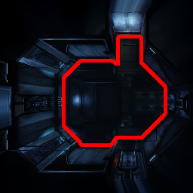
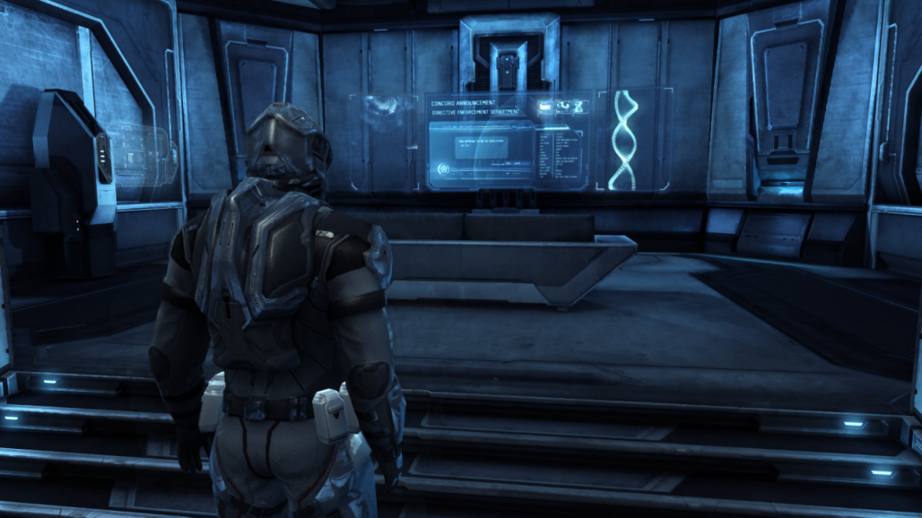
Walls
Notes:
With the tech I’ve described, walls have two problems. Firstly, the orthographic renders used to generate the layer textures will foreshorten or discard them completely. Secondly, the raytrace step will step right through them.
The merc quarters are a small room where you organize your character, the screenshot on the left shows what it looks like. As it stands, the tech will produce floor and ceiling layer textures that are completely black outside the room area. So if you walk your shiny character up to a wall, all the rays that go through the wall will fall onto blackness, and the impression the player will get is that the reflection of the walls is black.
The basic idea for the solution is to fold the walls down onto the floor layer. The image on the right shows the resulting floor layer texture. The main floor area is the dark area in the middle, outlined with the bright red line. Everything outside that line is folded-down walls. This won’t give an accurate reflection of the walls, but it does provide something plausible: the shapes and colors you see in the reflection match the floor and lower part of the wall.
The same can be done for the ceiling if need be – we did it here but it probably wasn’t really needed.
This is a pretty flimsy hack, and it’ll fall apart if you ask too much of it. For example, if both the floor and ceiling are folded into the layers, then you can easily end up with the same feature showing up in two different places in the reflection. So this approach won’t be able to provide a convincing reflection of a noticeable symbol on the wall, for instance.
For this room I set up the textures by deleting the roof and taking a screenshot of the room from above with a big FOV, applying it to some simple geometry at floor level and aligning it to the room, and then setting up the object flags so it was the only thing rendered into the floor layer.
There’s other, more general ways to do this described later.

Slide 24
Summary
+ Provides universal indirect term
+ Provides universal reflection term with variable blur
+ Fast
- Can’t support scenes with arbitrary height complexity
- In general, can’t cope with walls and vertical surfaces
- Dynamic objects won’t contribute to indirect or reflection
- Limited reflection quality
Notes:
The tech I’ve described here is a distant and simple relation of the sparse octree voxel tech published by Cyril Crassin. Instead of an octree we’re using layered 2D textures which are much faster and simpler to generate and sample, but much less general.
It shares a couple of the advantages, such as support for geometry, lighting or texture changes at runtime, and needs very little precalculated data. Also, there’s no per-object state. In comparison, using per-object spherical harmonic lightprobes for dynamic objects leads to problems with things like mesh particles , instanced geometry or very large objects.
The approximations we’ve taken mean it can’t provide reflections accurate enough for large mirrorlike surfaces. The quality problems aren’t easy to see with complex surfaces, less shiny materials or blurrier reflections though.
Dynamic objects are the biggest limitation – the lack of support for vertical surfaces can often be worked around for static objects, but there’s no realistic way to get reflections or indirect from other players, props or vehicles.
This approach is well-suited to environments with well-separated dynamic objects, and low height complexity. Racing and realtime strategy games would probably be a good fit. While it’s worked out OK for Dust, if the focus of the game was more on complex indoor environments this tech probably wouldn’t have been suitable.
In a nutshell – this tech provides indirect and reflection terms for any point and direction in space, but not at a high quality.
Obviously, with a higher rendering budget more is possible.

Slide 25
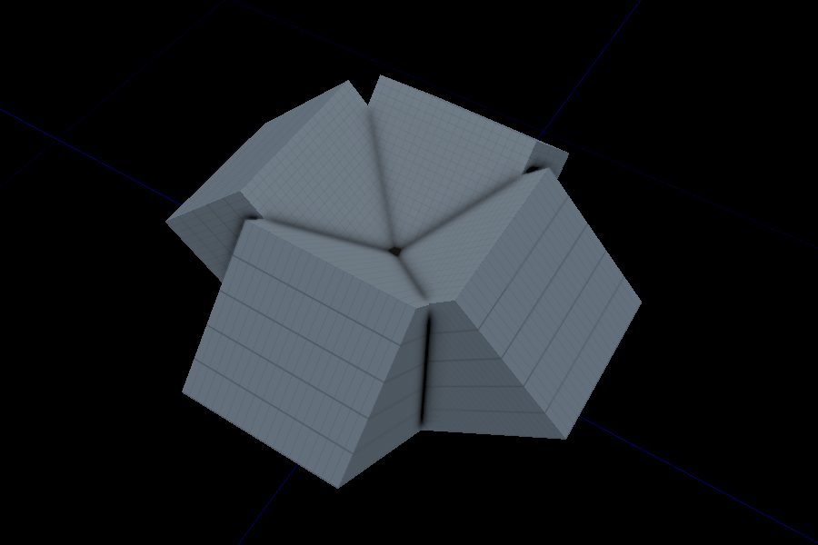
Multiple projections
Notes:
If you have higher rendering budget and want a more general solution then a sparse-octree lightcache is something you should seriously consider!
About the only way I can imagine to usefully extend the tech I’ve shown here to a higher budget is to do multiple orthographic projections. Instead of a single vertical set of layers, use three or four each slanted down, all converging on the active region as shown on the slide. This means surfaces of any orientation get proper coverage; also, it should be possible to improve the very basic heightfield trace code.
This approach would not cope if you had too many closely spaced vertical surfaces, such as a maze with thin, high walls. In comparison, a sparse-octree system is expected to cope with geometry of any complexity.
Anyway, it’s time to move on from next-gen speculation because the next topic is for current console hardware.

Slide 26
1920x1080, with AA
Notes:
So the second thing I’m going to talk about is getting Dust to render at full HD resolution, with antialiasing.
The idea behind this tech is to use a lower resolution for parts of the screen that are moving, and refine to high resolution and good antialiasing on static things.
So what we’re doing is a mix of temporal accumulation with subpixel jitter and upscaling. The scene is rendered at 1280x720 as usual, including postprocess, and then it’s upscaled to 1920x1080 and the UI is applied. The upscale takes 3ms but it replaces the 1.4ms FXAA pass, so the net cost is 1.6ms. It still does triple buffering, but does it with 2 buffers instead of 3 to keep the cost down, so it’s an additional 9.2MB of RSX memory.
It’s completely possible that this tech won’t make the cut for perf, quality or memory reasons, so while it’s working nicely there’s no guarantee that Dust will ship with it.
The tech is based on standard temporal antialiasing, so I’ll start there.

Slide 27
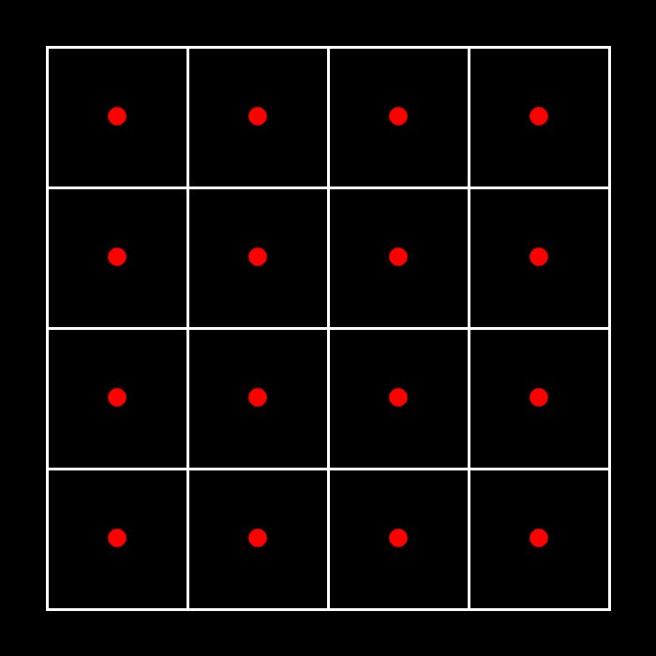
Background
Notes:
This slide shows a normal render at 4x4 resolution. The white squares indicate the area covered by each pixel. Red dots indicate the points the rasterizer will test for triangle intersections.

Slide 28
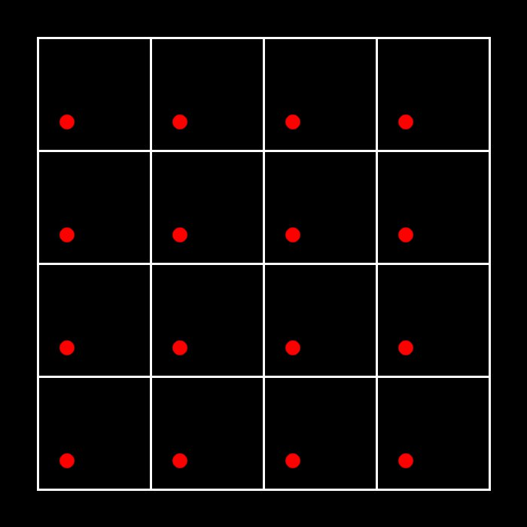
More background
Notes:
We can append a transformation to the projection matrix, which has the effect of transforming the sample points. One simple temporal AA approach is to perturb the samples within the pixels …

Slide 29
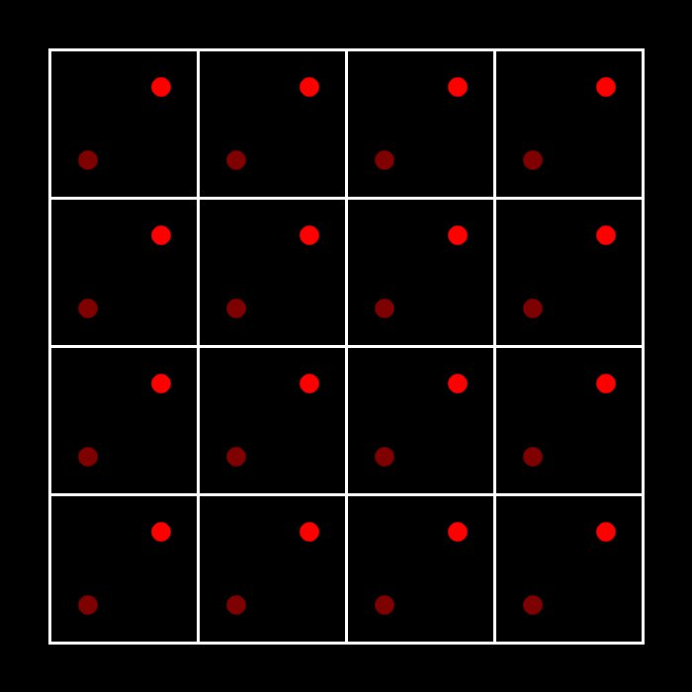
More background
Notes:
… and average the resulting images …

Slide 30
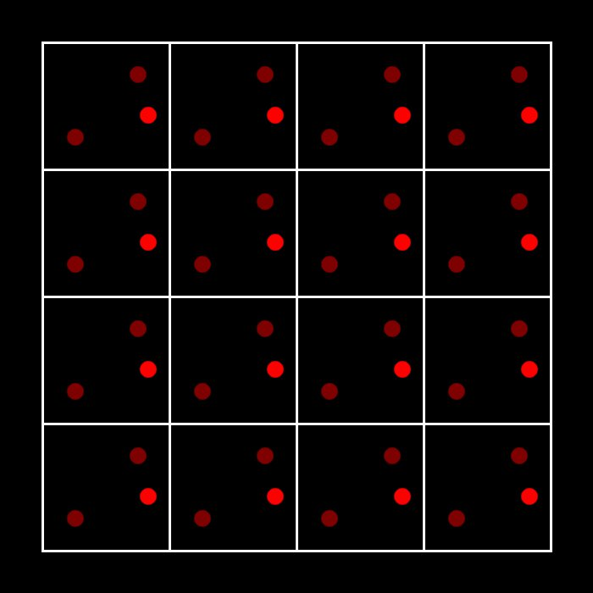
More background
Notes:
… and over time the color of each pixel will converge to the average of all samples within in, which results in a nicely antialiased image.
That’s fine for still images but doesn’t work for dynamic scenes. If there’s a dramatic change onscreen – for instance, an opponent running across the screen – then this accumulation strategy will mean we see a faint ghostly trail instead of a clear target, which is completely unacceptable. When there’s a dramatic change the player needs to see it immediately, and the only way to do that is to ignore the previous accumulated results and show the new image immediately.
However, a lot of the time, the viewer isn’t moving relative to things onscreen and it’s possible to accumulate those areas. For example, when running forward the things in the distance ahead of you will be more or less static and can be accumulated.
So to support moving images, you need to figure out whether each part of the screen is static or changing, and either blend in or immediately show the corresponding region from the current rendered image.

Slide 31
The last of the background stuff
For each pixel in the final image…
Is that part of the image static or changing?
If it’s static, blend in the current render
If it’s changing, immediately show the current render
Notes:
So here’s the high-level idea of how temporal antialiasing works.
The decision about whether the current pixel we’re processing is static or changing can be answered in a couple of different ways. If there’s a per-pixel velocity buffer for motion blur, great. We took a color-based approach for Dust 514 for a couple of different reasons.
I’ll come back to this question shortly, but first I’m going to talk about upscaling.

Slide 32
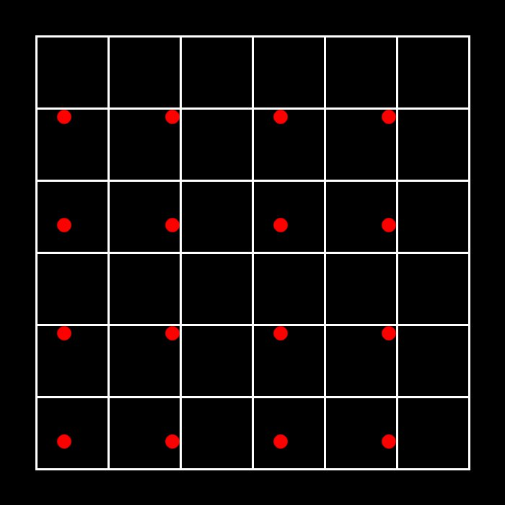
Upscaling
Notes:
For Dust 514, we’re using the same temporal accumulation idea and upscaling as well. Upscaling from 1280x720 to 1920x1080 is a scale by 150%.
This slide shows the same 4x4 render as in the previous slides, laid onto a final framebuffer that’s 150% larger. For each pixel in the final framebuffer we check if there’s a sample within our region; if so we accumulate. If not, we leave the target pixel unchanged. That’s the key difference between what we’re doing and the basic temporal antialiasing method I described earlier.

Slide 33
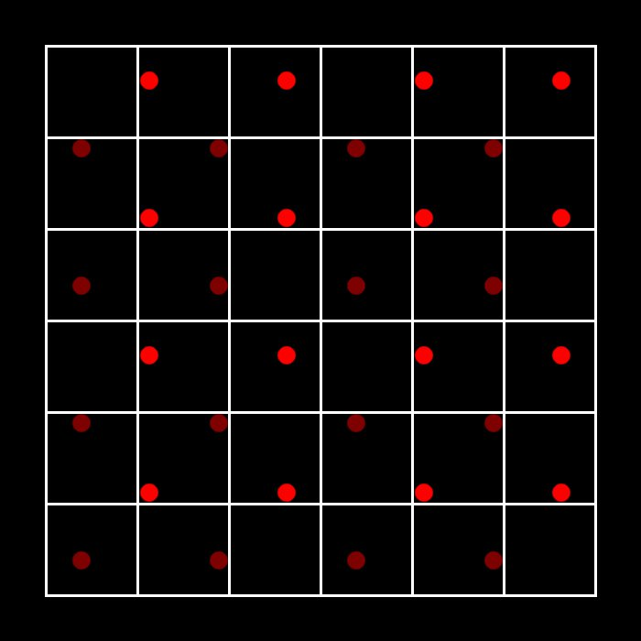
Upscaling
Notes:
Here’s what’s contributed by the second frame…

Slide 34
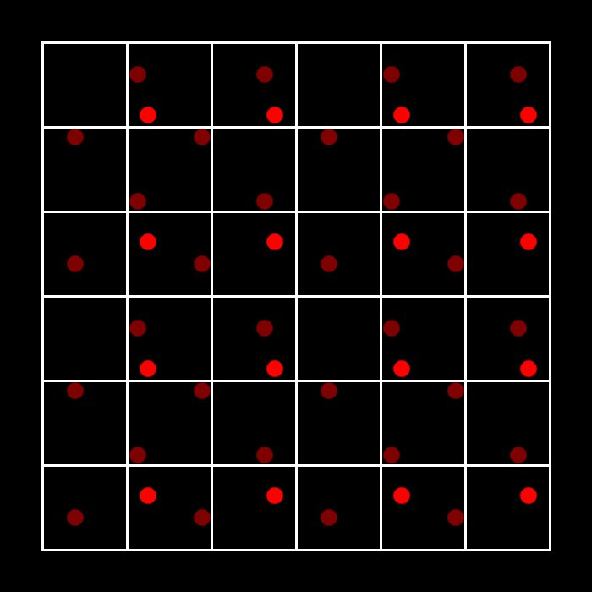
Upscaling
Notes:
… and here’s the third. Most of the pixels in the larger framebuffer have one or two samples, but a few have none. Obviously the bigger the scale factor, the longer it’ll take for the resulting image to converge. Going from 720p to 1080p means 2.25 times as many pixels.
Also, since we’re doing all the work to find the nearest low-res sample and work out whether it’s inside our pixel’s region, and we won’t have to cope with more than one relevant sample, we don’t need to restrict the post-projection transform to a linear scale and offset.

Slide 35
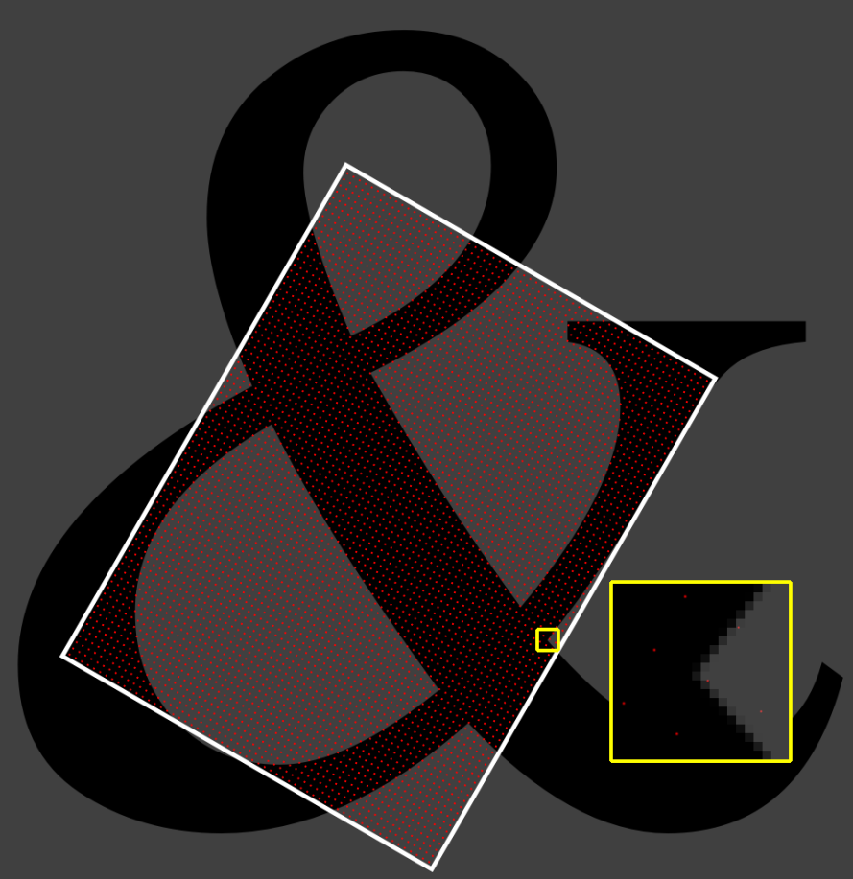
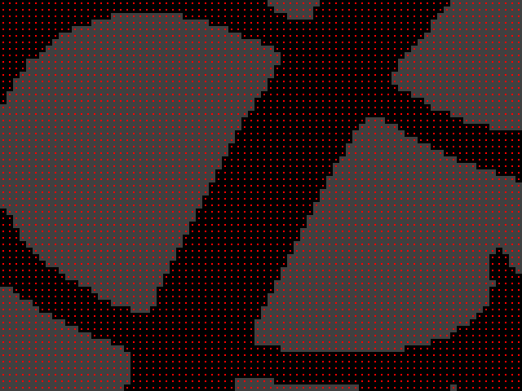
Accumulated and low-res images
Notes:
The post-projection transform doesn’t need to be a subpixel jitter; it could be a rotation or even some sort of homogeneous transformation. It doesn’t need to cover the whole of the high-res buffer either, although this has some obvious downsides. Anyway, to illustrate this I’ve used a rotation and partial coverage for the example shown on this slide.
On the left is the high-res antialiased result; on the right is the low-res input image rendered at 80x60 resolution.
The white rectangle on the high-res image shows the extents of the low-res image, and the blowup in the yellow outline shows the high-res result overlaid with red dots indicating samples from the low-res image. The scale factor is about 8 here – the spacing between low-res samples on the high-res image is about 8 high-res pixels.
The process for updating each pixel in the high-res buffer works as follow. First, it maps the destination pixel’s location to the corresponding point on the low-res buffer by applying the post-projection transform. Pixels on the high-res image that are outside the white rectangle will map to somewhere off the low-res image. We’ll gather some stats about the neighbourhood in the low-res image to decide whether the current hi-res pixel is static or changing, I’ll talk about that part soon.
Secondly, we then want to find if any low-res samples (red dots in the slide) fall within the area of the high-res pixel we’re processing. I’ll cover how that’s done shortly.
One other thing that needs to be pointed out is that you need precisely correct calculations for the locations of the low-res samples on the high-res image. Even a half-texel error will completely break the system if you have a scale or rotation in your post-projection transform. Calibrating this transform is a bit hairy, there’s a slide at the end with some notes.
Most of the reason I used a rotated render on this slide was to clarify the post-projection transform, but rotating the framebuffer does bring some advantages. For example, it means you’ll avoid the usual giveaways that appear with simple axis-aligned bilinear upscaling, such as the telltale stepping patterns. Also, it’ll break up thin axis-aligned subpixel features like thin streetlights, specular highlights on the edges of doors or pillars or vertical wall plates and so on that would cause trouble if the transform was just a scale and offset.
However, being able to rotate the framebuffer without dropping res will mean you need a bigger framebuffer for all rendertargets in the render pipeline which could add up to a lot of extra memory. Also, even if you mask out irrelevant pixels with depth or stencil there will still be a perf hit.
Before going into details of the accumulation, I’ll go through the buffer usage and memory cost for this tech.
At 32bpp, a regular 720p buffer costs 3.7MB. A 1920x1080 buffer costs 8.3MB, so each additional buffer is a pretty substantial allocation. Dust 514 is triple-buffered, and we’d like to stay triple buffered, but obviously we don’t want to pay the cost of three full HD buffers if we can avoid it.
We got the cost down to 9.2MB, here’s how.

Slide 36
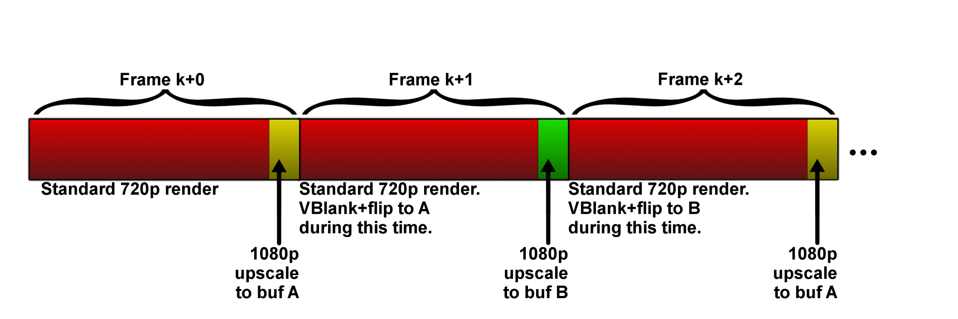
Triple buffering with two buffers
Notes:
The goals for triple buffering are that the GPU never stalls waiting for a pageflip to happen, and that the flips happen on vblanks so there’s no tearing.
The upscale and accumulate step ping-pongs between the two full-HD buffers A and B. Since we run at 30fps, and we only write to the full-HD buffer at the very end of the frame, it’s not a restriction to demand that there’ll be a gap of at least 16.6ms between writes. So once we’ve finished writing to one of those buffers we request a flip on the next vblank. In the normal course of events it’ll happen at some point during the main 720p render, and when we’re ready to start upscaling the next frame we can be confident that the flip will have happened.
We do need a fence to enforce this delay, as there are cases like menus and loading screens when the RSX very little to do.
We went from three 720p buffers to two 1080p buffers and one 720p buffer. So the additional memory required was about 9MB.

Slide 37
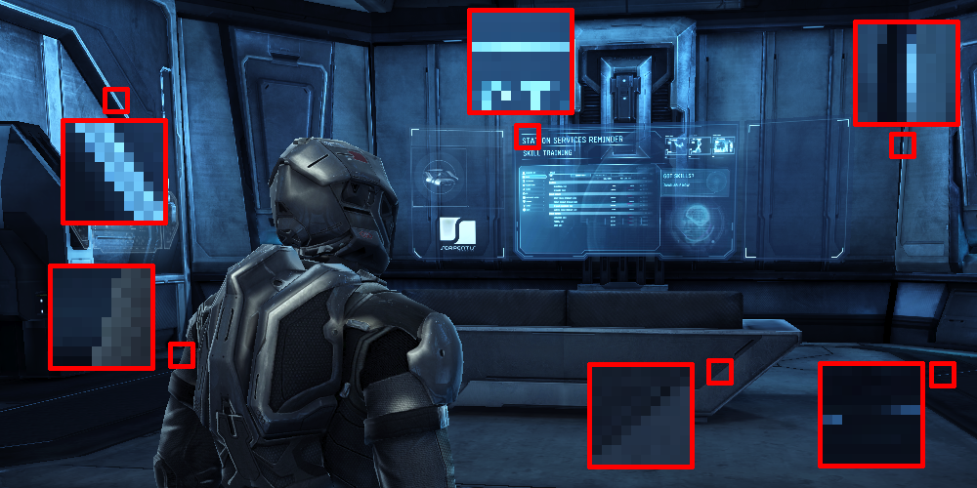
Static or changing?
Notes:
Returning to the upscale process, the first question is whether the pixel we’re processing is static or changing.
If it’s changing we want to throw away our accumulation and just upscale the low-res image.
The basic idea is to compare the current pixel in the high-res image with the neighbourhood of the corresponding point in the low-res image, and see if the high-res pixel’s color is consistent with that neighbourhood or not. I tried color variance, luminance variance, color extent and luminance extent and a few other approaches too. The best option was color extent – that is, find the range of colors in the neighbourhood, and if the high-res pixel color is within or very close to that bounding box then that pixel is static.
Unlike variance, the color bounds are pretty similar for any point close to a high-contrast edge which is a rather good property; high-contrast edges are where aliasing problems are most obvious so you need a robust solution for them.
This image shows the input low-res image to the system. This is in the merc quarters, which is one of the first things you see in Dust, and unhappily it’s also a nasty test scene for the upscaling tech. I’ve picked out five locations with relevant features and I’ll talk through each of them.
- The blowup at the bottom just to the right of the center shows a nice, simple case – two regions of pretty consistent color with a simple transition between them. If the shiny armour moved in front of it or the view panned a few pixels there would be no ambiguity that a change had happened.
- The area on the left at the bottom is also simple, since the armour has a color range distinct from the background.
- The area in the top left is also nice and straightforward; even though the bright line is just a few pixels wide it’s not a problem. The bounding-box test is very robust near the edges so you don’t get any noticeable artifacts.
- The area in the top right is where things get interesting. The edge has a very slight specular highlight so there’s a slight subpixel-wide bright region between the dark background to the left and the mid-blue to the right. When using random subpixel jitter this bright band jumps up an down the edge, and if you’re using the basic color-extent test then those bright areas will be out of range and they’ll be upscaling rather than accumulated, causing noticeable fizzing up and down the edge.
- In the bottom right we have some horribly undersampled geometry which introduces a scattering of bright pixels on a background of constant-colored dark pixels. Those bright pixels will always be detected to be an abrupt change, and doing a simple upscale means those bright pixels are scaled up by 150% thereby magnifying the fizzing.
- Lastly, the region at the top is sheer murder. It’s a part of a high-tech info screen which has a video being played on it. When a frame of the video is decoded to texture no mipmaps are generated, and the image has lots of axis-aligned high-frequency detail, and at this distance it’s being undersampled, and we’re doing a random subpixel jitter every frame. So all the letters and the long, texel-high horizontal lines fizz like crazy.
I’ll explain how we dealt with all those problems, but first I’ll go over the accumulation step.

Slide 38
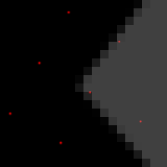
Accumulation step
Notes:
If we’ve decided that the current pixel we’re working on is static, then we need to find out of any low-res samples – they’re the red points on the slide - fall within the area of the high-res pixel we’re processing. If there is one, we want to blend it in to our running average color, but if not we leave our current pixel unchanged.
One way to figure out if there’s a low-res sample within the current pixel is this. Start by mapping the current high-res pixel center to the low-res buffer using the post-projection transform – this step is shared with the neighbourhood gathering. Quantize the position on the low-res buffer to the nearest texel center, then map that position back to the high-res image and see if the resulting point is within the region of the current pixel we’re working on. That sounds expensive, but it’s straightforward to boil most of the maths down to a single linear operation which can be lifted to the vertex program and a new UV, and the remaining inside/outside test can be answered with a texture. So, in the pixel shader the whole operation reduces to a single texture lookup.
My original goal for this was to maintain a mathematically correct average color: when k samples were blended together the current color was an equal blend of all of them. The alpha channel would hold 1/(k+1), and would be the parameter to lerp in when a new sample arrived. So when the second sample arrived the result would be a 50% blend of the first two samples. When the third sample arrived the running average would contribute 2/3 and the new sample 1/3. And so on.
This worked, but temporal problems were the biggest challenge and forcing the blend to a fixed value such as 10% worked better.

Slide 39
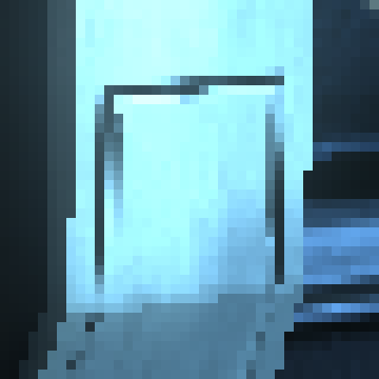
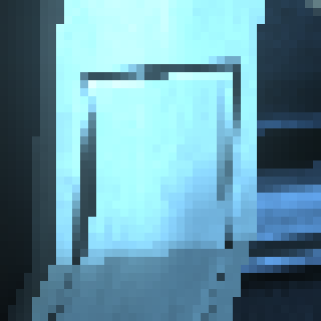



Abrupt change
Notes:
If we’ve decided that the current pixel we’re working on is changing, then we need to stop accumulating and upscale.
This is where things get complicated, because there’s lots of cases where the subpixel jitter causes undersampled features to cause mischief – such as the case shown on the slide. On the left are four raw input frames; on the right is the result.
In the input frames there’s a lot of pixel-wide lines that shift around unpredictably, and they’re interpreted as an abrupt change. There’s a ton of other cases where this happens, this is unusually bad case but definitely isn’t an isolated example. Simply doing a bilinear upscale in these cases will make things worse, it basically magnifies the fizzing.
One option would be to gather more info – sample a larger neighbourhood, or previous frames, for instance, but that’s probably not affordable for the PS3; five bilinear samples is pretty much all we can afford.
I tried a lot of options here and the key thing that helped is to blend in the new color based on size of color bounding box that was calculated for the static vs changing question. A small range means relatively flat color – for instance, the sky or ground appearing due to the camera moving or panning. So if the color extent is small, the previous frame has a small or zero contribution. This means flat areas of color appear immediately and we avoid ghosting.
If the color range is large it means we’re on a sharp edge, or on an undersampled feature, or in a noisy region. In that case we reuse a lot of the previous frame and only blend in a small amount from the low-res buffer. This especially helps in noisy undersampled regions where there would otherwise be continuous fizzing, like the case shown in the slide – around the high-contrast edges everything will blend in more slowly.

Slide 40

Results
Notes:
Here’s the resulting 1080p image with closeups. The topleft and bottom center blowups are the two simple cases and they’re fine.
The character goes through some idle animations so there was a bit of movement when this image was taken. The bottom left blowup shows some jaggies – there’s nothing offensive, but problems are more apparent in motion.
The top right image has converged to a nice clean result and the undersampled specular is causing no problems.
The horrible undersampled geometry on the right at the bottom yields only a light band and no flickering.
The worst case of all is the video screen. There are still some minor temporal aliasing problem, but obviously those can’t be communicated with a screenshot. For instance the long horizontal lines flicker slightly – there’s a faint but noisy smear visible above the letters in the topmost blowup. The letters themselves are pretty robust though.
This method also upscales bloom and other postprocess effects so long as they respond properly to the subpixel jitter – I haven’t picked out any examples, but you can see the two lights in the very bottom right of the image have a bit of bloom around them.

Slide 41

Results
Notes:
So this technique will genuinely provide a 1920x1080 image for a pretty minimal cost; it’s 3ms on the PS3. It works really well with static geometry and a fixed camera, works OK with slow-moving features, and falls back to upscaled 720p for fast-moving features.
The biggest weakness is the central feature of this approach: the subpixel jitter. Subpixel jittering introduces temporal problems like fizzing, whether it’s due to z-fighting, shader aliasing, lack of mipmaps on video textures, undersampled bloom, or any of a hundred other things. While blending in new colors based on color-extent magnitude is pretty good at covering up those temporal problems, they can still be an issue and might well be a dealbreaker.
A crucial variable is the balance between responsiveness to change, and quality of antialiasing. You can tweak things so there’s no fizzing but then you get ghosting effects – this means small details get lost and the scene can start to dissolve into blocks of solid color. Alternatively you can tweak things so movement is picked up immediately, but this means undersampling problems and fizzing.
So the fewer problems you have with subpixel jittering, the better.

Slide 42
Improvements with more budget
Motion blur
Better static vs changing decision; eg analyze a larger neighbourhood
Better AA for abrupt change case, eg FXAA
Notes:
Obviously, motion blur is the natural fit for this sort of tech – it’ll do a lot to cover up the low-res source image for moving features. It’ll complement the image-based refinement decision, so there are nice outcomes like high-contrast edges parallel with the direction of motion will be refined.
Analyzing a larger neighbourhood and perhaps previous frames should mean it’d be possible to make much better decisions about whether the current pixel is static or changing.
It’d be great to use FXAA to improve the antialiasing quality when upscaling.
For Dust, the temporal problems are under control and the biggest quality problem is fast-moving features. So I’m looking into ways to integrate FXAA into this tech without blowing the budget.

Slide 43
Thanks to…
Anders Caspersson
Chris McClure
Dominic Goulding
Halldor Fannar
Lee Clark
Richard Smith

Slide 44

?
Notes:
Questions?

Slide 45
Bonus slides!

Slide 46
Heightfield refinement details
half4 incremental_heightfield_update(
float2 curr_uv,
sampler2D last_heightfield,
sampler2D raw_heightfield_from_scene,
half enforced_gradient)
{
half new_height=tex2D(raw_heightfield_from_scene, curr_uv)).r;
for(float2 direction in +X, -X, +Y, -Y)
{
for(float step_distance in 1, 4)
{
float2 query_uv=curr_uv+(direction*step_distance);
new_height=max(new_height, old_height(query_uv).r-step_distance*enforced_gradient);
}
}
return new_height;
}
Notes:
Here’s some pseudocode that gives the idea of the method. The function here is called when we’re processing a heightfield to constrain the gradient.
The GPU has done an orthographic render of the scene to generate a heightfield – this is the parameter raw_heightfield_from_scene in the function above. The parameter last_heightfield is the last iteration of the heightfield we’re processing.
What the function does is take a maximum of a couple of different samples. It takes the height of all the texels one step away, and ensures that the new height is at least one step below them. It takes the height of texels four steps away and ensures that the new height is at least four steps below them. This process is repeated every frame and it quickly converges to a heightfield with the desired maximum gradient. The crucial things controlling how fast the process converges and how it copes with change are the set of step distances, and the parameter enforced_gradient. We ended up alternating between step distances of 1 and 4, and 1 and 16 on alternate frames so changes could quickly propagate long distances. This is just an acceptable solution, not a finely tuned and researched set of values though.
This function assumes the heightfields are all packed into the red channel. I mentioned earlier that we used four textures and four heightfields in Dust 514. These four heightfields are packed into the RGBA channels of a single texturemap, and so this incremental update function updates all four in parallel. Also, two of the four heightfields are rendered from above and two from below, so for two of the channels we want to use max() as shown here and the other two use min(). It’s still pretty straightforward to parallelize all this though, so all four heightfields are updated in each pass.

Slide 47

Area lights and shadows
Notes:
Processing the heightfield to enforce a maximum gradient has some benefits for the indirect term too. This image shows just the indirect term.
The pipe is in the bridge layer and it’s masking out the sky, and it’s causing the dark patch on the ground underneath. Where the ground meets the pipe it’s got a relatively hard edge, and where the pipe is higher there’s a much softer edge.
Here’s how this effect happens. When shading the ground the “up” ray is traced against the bridge-below layer and the ceiling layer – or conversely, the up color is set to the sky color first, then the sample from the ceiling layer is blended into it, then the sample from the bridge-below layer is blended in. The ceiling layer is completely transparent here so it has no effect, but the bridge-below layer has a long dark rectangle from the underside of the pipe.
The mipbias used to sample the layer textures is based on the height difference. For the bridge-below texture, it’ll increase as the pipes become further from the ground, causing the increasingly wide and soft dark area on the ground due to the transition from opaque black to transparent becoming wider and blurrier as progressively lower-resolution mipmaps are sampled. The layer textures use premultiplied alpha and trilinear mipmapping to avoid artifacts.
Without the heightfield refinement step, this effect wouldn’t work. The bridge-below heightfield would change abruptly at the sides of the pipe, so we wouldn’t get the impression of a soft shadow from an area light.
This effect works with any layer, so we can have shaped area lights on the floor or ceiling that appear to cast plausible soft shadows – with the usual list of restrictions and caveats, of course!

Slide 48

Greater height complexity
Notes:
I’ve suggested dividing space up into three sections – floor, bridge and ceiling. This isn’t enough to support things like parking garages, or tower blocks. Here’s one way to support these environments.
This slide shows a cross-section of a building. Overlaid in orange hatching are a lot of different options for where the splits between those three layers could happen – they’re in the same line style as the yellow and red surfaces shown on the “Layers” slide earlier (slide 12) because they’re so closely related. Those yellow and red divisions on that earlier slide split space into the three sections, and environments like this could be supported if those splits could be changed at runtime. Let the floor-to-bridge split be the orange divider just below the camera, and the bridge-to-ceiling split to be the orange divider just above the camera. This would mean the player could move freely around multilevel environments such as this without problems.

Slide 49


Space distortion for folding walls
Notes:
Here’s some other ways the tech can be extended to support walls.
One way is to use a perspective rather than orthographic projection to generate the layer textures. I haven’t tried this because I was expecting the parallax changes with movement to mess up the indirect and reflection terms the same way non-quantized movement does, and the fact we’re updating the layers only every 5 frames to cause popping.
A related option is to use a shear based on view direction instead of a perspective projection; this means the layers could still be scrolled and the shifts in reflections and indirect would only happen during view rotation which may help to cover them up. Again, the 5-frame round-robin delay would probably cause unacceptable artifacts.
A more general solution is to set up a continuous space deformation to fold the walls down, apply it when generating the layer textures, and apply it to the raytraces so a raytrace in a wall turns into a near-vertical ray onto a flattish surface. A cross-section of the distortion is shown here. On the left is the original situation with the floor shown in green, the wall in orange, and the blue grid showing the original undistorted space. The image on the right shows the space distortion needed to fold the wall down.
A horizontal ray close to a wall will map to a near-vertical ray close to a flat plane. This change means the raytraces will produce a much more accurate intersection. Of course, so many other shortcuts and approximations have been taken that this still won’t produce an accurate result!
Also, folding the walls down like this requires space for them to fold into – so it’ll work for very thick walls where there’s space, but thin walls which can be seen from both sides are still a problem.

Slide 50

Post-projection transform calibration
Notes:
This image shows a test to check the maths deciding whether the destination pixel we’re shading in the high-res image contains a sample from the low-res image.
The postprojection transform is rotated slightly each frame, and there’s a large constant scale factor. If the pixel on the high-res image contains a sample from the low-res image then use the low-res color, otherwise leave the high-res pixel untouched.
What you get is a regular grid of points rotating slowly. The part of the scene we’re rendering has a simple straight border with blue and green on each side. As you can see there’s a clean border developing in the high-res image – you can connect the locations where the colorchange happens and they’ll form a straight edge. If you leave it to run for long enough the image will converge with just pixels on the border changing.
If there were any errors in the maths then the image will not converge that cleanly, and the border will never resolve.
If the sample-in-pixel test is not quite right then either the lines you can see in the image will be broken up, or fatter than a single pixel.
Anyway, the thing that needs to be calibrated is the sub-texel offset specifying locations on the low-res texture – basically, if the UV is scaled up by imagesize are the samples on integer or half-integer positions? The answer differs between OpenGL and Direct3D, and may be complicated by the render-to-texture step too.
The method I used to find the offset was based on the test shown here.
Render simple test scene shape, and have the scaleup ratio very high so there’s a big gap between samples
On alternate frames use a rotation of 0 and 180 degrees
Adjust V offset until the border is identical in both cases
On alternate frames use a rotation of 90 and 270 degrees
Adjust U offset until the border is identical in both cases
After that the continuous rotation test shown here should converge to a clean border.

